Slide 1
Introduction to the mbed Platform

Slide 2
Module Outline
mbed Overview
Introduction to mbed
mbed Software Development Kit (SDK)
mbed Hardware Development Kit (HDK)
mbed Development Tools
mbed Worldwide Developer Community
mbed and Internet of Things

Slide 3
mbed Overview

Slide 4
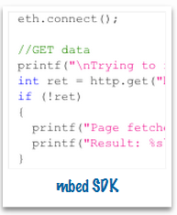
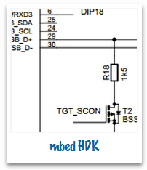
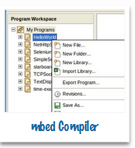

Introduction to mbed
What is mbed?
mbed is a platform used for easy prototyping and development of applications and systems based on ARM Cortex-M-based microcontrollers
mbed platform provides
Open software libraries
Open hardware designs
Open online tools for professional rapid prototyping of products based on ARM-based microcontrollers
mbed platform includes
A standards-based C/C++ Software Development Kit (SDK)
A microcontroller Hardware Development Kit (HDK) and supported development boards
Integrated Development Environment (IDE), including an online compiler and online developer collaboration tools

Slide 5

mbed Software Development Kit
mbed Software Development Kit (SDK) includes:
Software libraries
Official C/C++ software libraries
Start-up code, peripheral drivers, networking, RTOS and runtime environment
Community-developed libraries and codes
Cookbook of hundreds of reusable peripheral and module libraries have been built on top of the SDK, which can be used to build your projects faster
Software tools, such as build tools, test and debug scripts
Other features
Licensed under the permissive Apache 2.0 licence – all codes can be used in both commercial and personal projects with confidence
Compatible with different hardware platforms
Support for multiple tool chains
Details on how to use the SDK will be
introduced in later modules

Slide 6
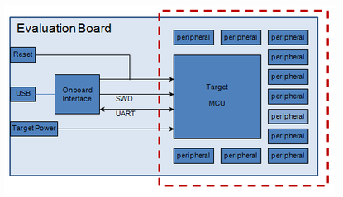
mbed Hardware Development Kit
The mbed Hardware Development Kit (HDK) provides
Recipes to build custom hardware devices
Microcontroller sub-system design files and firmware
Specifications of all support components and circuits
mbed hardware platforms, off-the-shelf development boards
Benefit of the HDK
Quick design short-cut using ready-
made schematics
Provide easy-to-use USB and debugging
support
Compatible with mbed SDK
An example of how a microcontroller sub-system might be used to build an evaluation board

Slide 7
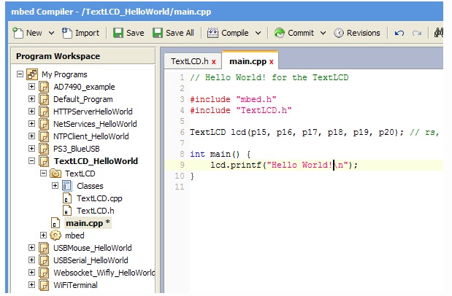
Integrated Development Environment
The mbed IDE provides an mbed online compiler and toolchain for rapid application development
Lightweight tools
Online web-based IDE – your project can be accessed from anywhere
No installation needed, only web browser needed
Free-of-charge
Convenient code sharing
Everyone can Import
codes/libraries from others
Everyone can export
codes/libraries to the community
Online mbed IDE

Slide 8
Examples of mbed Hardware Platforms

Slide 9
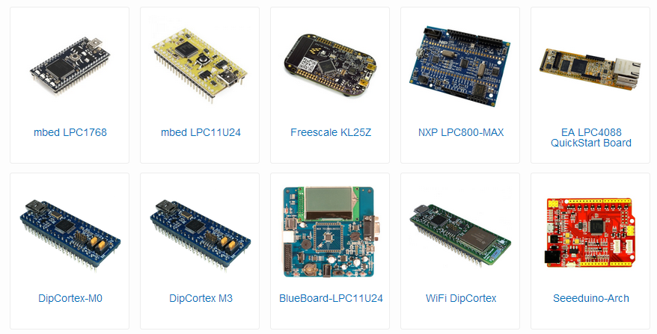
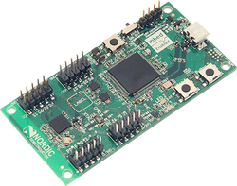
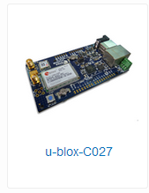
Examples of mbed Hardware Platforms
mbed hardware platforms are already manufactured development boards that are:
Based on the mbed HDK
Quickest way to get started with the mbed platform
Specifically optimised for flexible rapid prototyping
Available from distributors worldwide, examples are:
Nordic nRF51822

Slide 10
mbed and Internet of Things

Slide 11


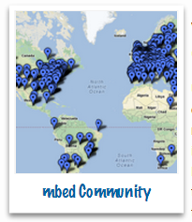
mbed and Internet of Things (IoT)
One major role of IoT is to connect the world’s objects in an interoperable standards-based way
To build these standards, mbed provides tools and facilities to rapidly prototype these things to build working proof-of-concepts
Apart from the fast prototyping tools/platforms, mbed also provides special features for IoT development, including:
Support for HTML5 web standards – a new protocol in HTML version 5 that supports easy real-time data links from any source to any destination
ARM Sensinode NanoServiceTM – provides end-to-end software products that bring IP and web services to the end node
mbed world-wide community – a huge open source repository of codes and libraries shared among developers worldwide

Slide 12
Useful Resources
mbed website:
http://www.mbed.org
ARM Cortex-M:
http://www.arm.com/products/processors/cortex-m/

